Slide 1
HP QC ALM
Training Material

Slide 2

Agenda
ALM Basics
Releases Module
Requirements Module
Risk Based Quality Management
Test Plan Module
Requirements Coverage
Test Lab Module: Test Execution
HP Sprinter
Defect Module
Version Control
Library Management
Reporting & Analysis

Slide 3
ALM Basics

Slide 4
Quality Center Overview
Quality Center is a web- based Test Management tool ( client - server architecture) and helps maintain a database of tests.
Quality Center can be integrated with e-mail systems which facilitates automatic email reminders for bugs or other testing activities.
Quality Center is a one stop shop for all testing related tasks and provides for easier analysis , test management and test tracking.
You can use Microsoft Word and Excel Add-ins to import data from Word and Excel into Quality Center

Slide 5
ALM Basics
HP Application Lifecycle Management (ALM) empowers IT to manage the core application lifecycle, from requirements through deployment, granting application teams the crucial visibility and collaboration needed for predictable, repeatable, and adaptable delivery of modern applications.
Aim of effective Life Cycle Management
  Greater predictability
  Heightened repeatability
  Improved quality
  A ready accommodation of change
  Simplifies and organizes systematic control over the process

Slide 6


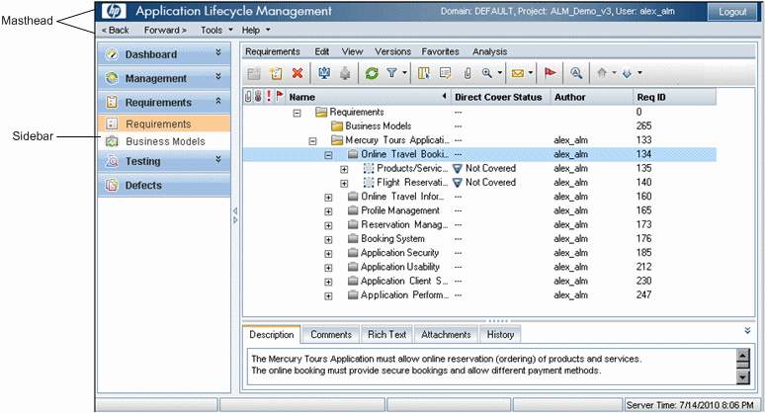
ALM Roadmap
  ALM masthead. Contains navigation buttons, access to common tools, documentation and additional resources.
  ALM sidebar. Contains buttons enabling you to switch between ALM modules.

Slide 7
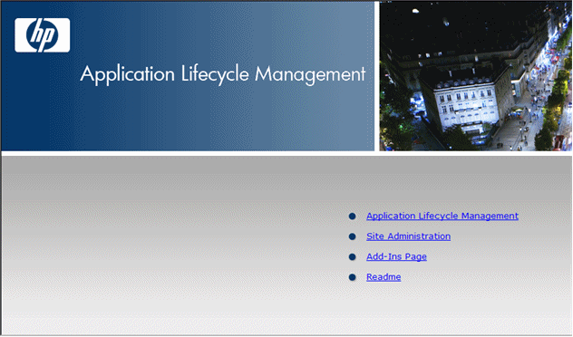
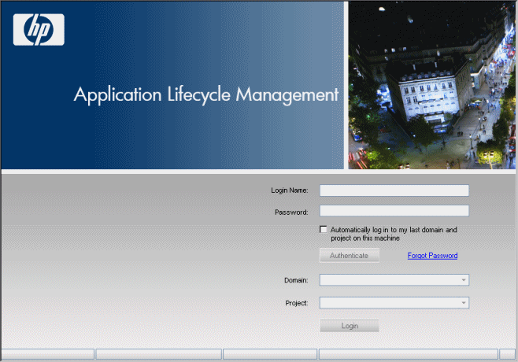
ALM Login
Invoke the Web Browser or QC Explorer
  Key in the URL “http://<ALM Platform server name>[<:port number>]/qcbin

Slide 8
Releases Module

Slide 9
Management – Releases & Cycles
Release - A release represents a group of changes in one or more applications that will be available for distribution at the same time. Each release can contain a number of cycles.
Cycle - A cycle is a set of development and quality assurance efforts performed to achieve a common goal based on the release timeline. Both releases and cycles have defined start and end dates.
After defining releases and cycles, you define and review requirements and assign them to releases and cycles.
Requirements describe in detail your application needs, and are used as a basis for creating a test plan. The tests you create during the test plan phase should cover these requirements.
After assigning requirements to releases and cycles, you create test set folders and assign them to cycles. A test set is a group of test instances in an ALM project designed to achieve specific test goals. After assigning test set folders to a cycle, you run the test sets under these test set folders.

Slide 10
Management – Releases & Cycles contd..
If an application flaw is detected while running a test set, you can submit a defect. ALM automatically creates a link between the test run, associated release and cycle, and the new defect.
A defect can be submitted to an ALM project from any module at any stage of the application management process. While reviewing and deciding which new defects need to be fixed, the defects can be assigned to the appropriate release and cycle.
Following test runs, you can review the test progress to determine how well it meets the release goals. You can also determine how many defects were resolved, and how many still remain open. The results can be analyzed at a release or at a cycle level.
You can track the progress of the application management process in real time by analyzing the releases tree and ensuring that it matches the release goals.

Slide 11
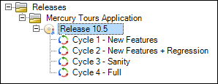
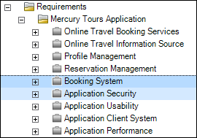
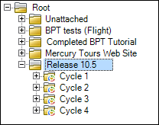
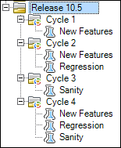
Working in Releases
Define Releases and Cycles
  Open the Releases module, Create folders, Add releases to folders, Add cycles to a release
  Assign requirements
  Assign to release. Right-click a requirement and select Assign to Release.
  Assign to cycle. Right-click a requirement and select Assign to Cycle.
  Assign and run test sets
  Assign to cycles. Right-click a test set folder and select Assign to Cycle.
  Run tests.
  Assign defects
  Assign defects to a target release and a target cycle

Slide 12
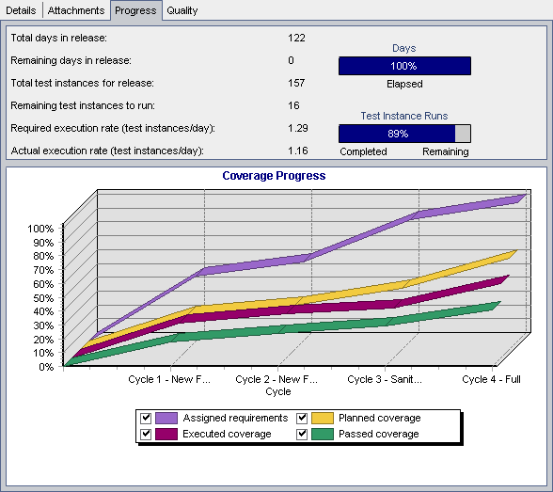
Analyze Releases & Cycles
The Assigned requirements curve indicates the distribution of the assigned requirements within the release's cycles. In this example, the curve indicates a 100% value in the Cycle 4 - Full cycle.
The Planned coverage curve below the Assigned requirements curve indicates the percentage of requirements that are covered throughout the release. In this example only 60% of the requirements are covered in the Cycle 4 - Full cycle.
The Executed coverage curve below the Planned
coverage curve indicates the percentage of tests that were run as the release progressed.
In this example, the curve indicates that at
Cycle 4 - Full only 40% of the assigned tests were run.
The Passed coverage curve is below the Executed coverage curve. It indicates the test runs in which the most recent status is passed. In this example, the curve indicates a 20% value in the Cycle 4 - Full cycle.

Slide 13
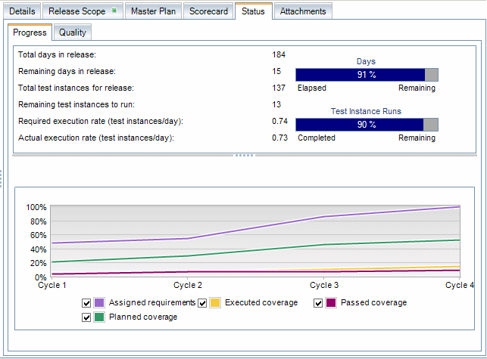
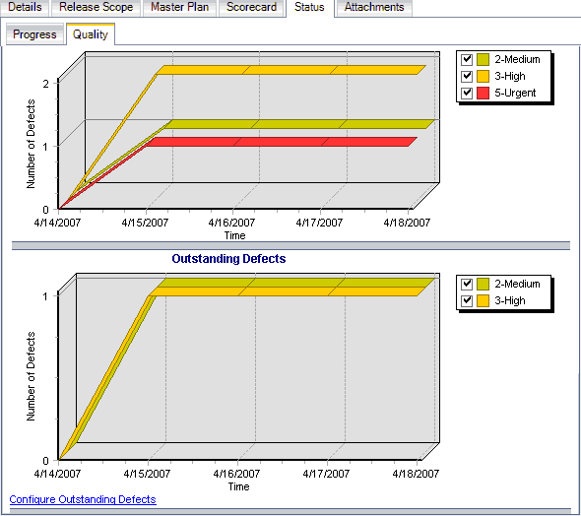
Progress & Quality Tab

Slide 14
Release Module Demo

Slide 15
Project Planning and Tracking Releases
A release scope item refers to a subdivided section of a release, for example a new feature, a change to an existing feature, or a new theme.
For each scope item you define the related requirements, tests, test sets, and defects.
To measure the progress of the release scope items, you associate them with milestones.
Available only in Premier Edition
A milestone is a point in the time-line of a release that signifies the completion of a deliverable. It enables you to track and validate the progress of the release.
A milestone can be associated with one or more release scope items.
PPT collects and analyzes the data from the defined milestones using key performance indicators (KPIs).
PPT uses the KPIs to analyze a milestone’s readiness data, and to show the overall health and deployment readiness of a release in the form of a scorecard. The scorecard monitors and tracks how well each milestone is being met on a daily basis.

Slide 16
How to work with PPT
Define Releases
  Add new releases. Alternatively, if the project is linked with the template, Right-click a release folder and select New Release from Template.
Define Release Scope Items
  In the releases tree, select a release. Click the Release Scope tab. Add release scope items and define the related requirements, tests, test sets, and defects
Define Milestones
  Right-click a release and select New Milestone, associate the milestones with the release scope items in Milestones Scope Tab
  Associate KPIs. Click the KPIs tab. Configure related KPIs and set boundaries for performance against those KPIs.
Analyze Progress
  View scorecard. In the releases tree, select a release. Click the Scorecard tab. View the status and progress of your defined milestones.
  View Gantt chart. In the releases tree, select a release. Click the Master Plan tab
  Create PPT graphs

Slide 17
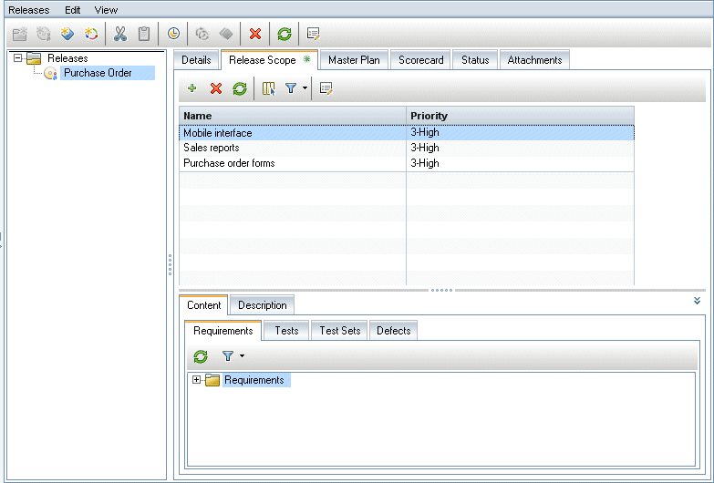
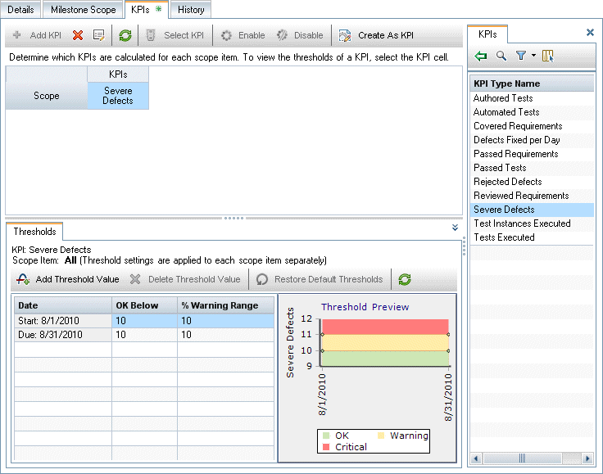
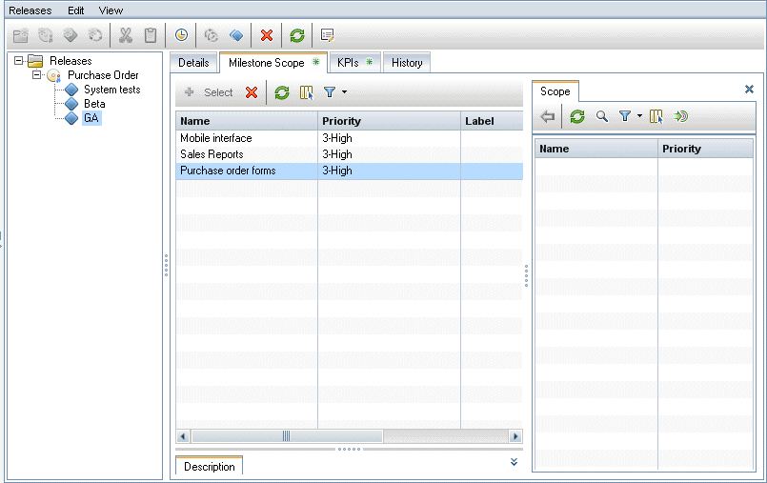
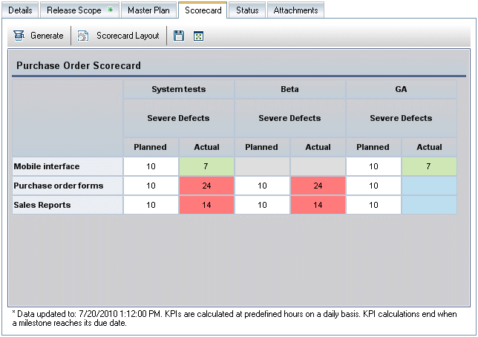
PPT Demo
1. Define Release releases scope items
3. Define KPI
2. Define a Milestone
4. Analyze progress - Clicking KPI cells enables you to drill down and display calculations as graphs

Slide 18
Requirements Module

Slide 19
Requirements Overview
Requirements describe in detail what needs to be solved or achieved to meet the objectives of your application under development.
Clearly and correctly defining requirements at the front end of a project provides the following advantages:
  Provides stakeholders guidelines of what the priorities are
  Sets clear expectations between stakeholders
  Cuts waste and eliminates unnecessary expenditure
The Requirements module enables you to define, manage and track requirements at all stages of the application lifecycle management.

Slide 20
Working with Requirements
Prerequisite
  Determine the requirements scope by gathering information such as functional and technical specifications, marketing and business requirements documents, and stakeholders goals.
Examples
  What is the main purpose and direction of the application?
  What are the critical constraints of the application?
  What are the major features of the application?
Create requirements
  Define a hierarchical framework for your requirements scope by creating a requirements tree.
  You then assign the requirement a priority level which can be taken into consideration when creating the test plan
Import business process models
  If you work with business process models, you can create a framework of requirements by importing models created with standard modeling tools.
Trace requirements
  You can add traceability between the requirements. When analyzing the impact of a change proposed in a specific requirement, traceability shows the other requirements that the change might affect
Calculate risk
  Use risk-based quality management to calculate at which level to test each requirement, based on the nature of the requirement and the resources you have available.

Slide 21
Working with Requirements.. contd.
Create coverage
  Create coverage between your requirements and tests to ensure that all requirements are implemented in the project
Link to defects
  You can link a requirement to specific defects. This is useful, for example, when coverage is created between requirements and tests. Linking defects can help you ensure compliance with your requirements and testing needs. If a requirement changes, you can immediately identify which tests and defects are affected, and who is responsible.
Assign to releases
  Assign requirements to releases or cycles defined in the releases tree in the Releases module.
    Assign to release. Right-click a requirement and select Assign to Release.
    Assign to cycle. Right-click a requirement and select Assign to Cycle.
Analyze requirements
  Review your requirements to ensure that they meet the defined requirements scope. After a requirement is approved, you change the status of a requirement from Not Reviewed to Reviewed
Establish baseline
  Create a baseline to sign off on or compare significant milestones in your application lifecycle

Slide 22
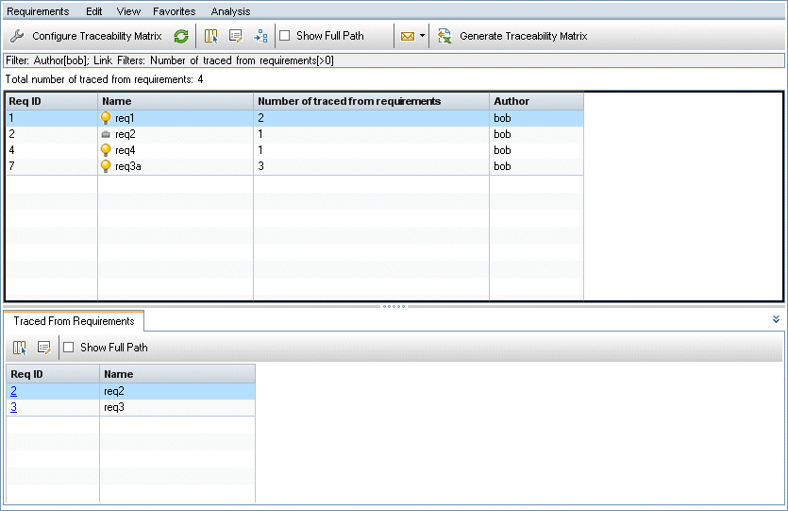
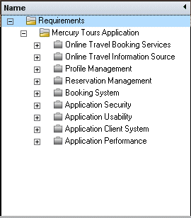
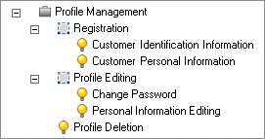
Create Requirements
Requirement Views
    Requirements Tree
    Requirements Details
    Requirements Grid
    Coverage Analysis
    Traceability Matrix
    View traceability relationships between requirements and other requirements or tests in a matrix
Create Requirements
Import Requirements
Update Requirements
Convert Requirements to Tests
  Convert requirements to tests – Right click a requirement or folder and select Convert to Tests.
  Convert requirements to tests and add them to a test set. - Right click a requirement select Generate Test

Slide 23
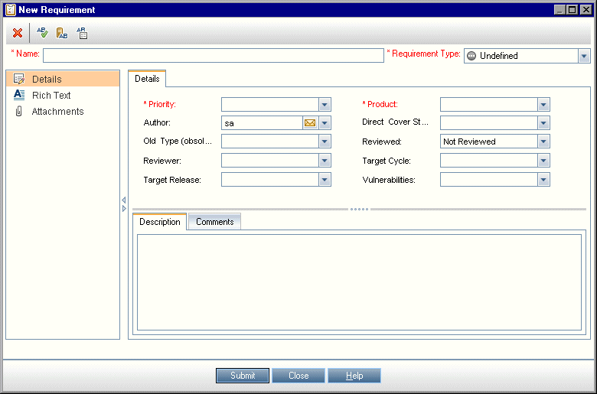
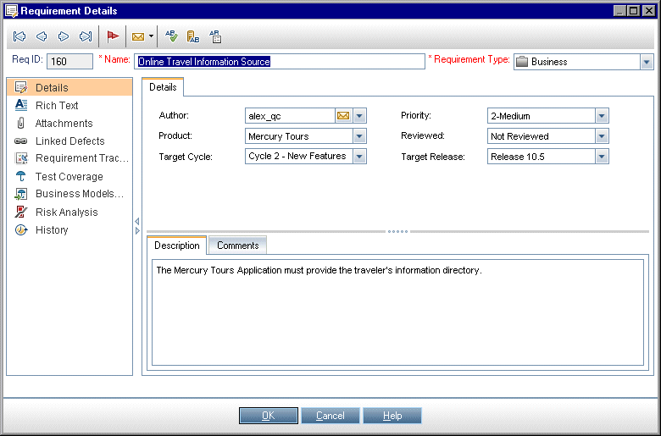
Requirements..contd..
New Requirement Page
Requirement Details Page

Slide 24
Risk Based Quality Management

Slide 25
Risk-Based Quality Management
The risk-based quality management feature enables you to calculate at which level to test each requirement, based on the nature of the requirement and the resources you have available
Each requirement type with risk-based quality management enabled can support either risk analysis which is referred to as an analysis requirement, or an individual risk assessment which is referred to as an assessment requirement
  An analysis requirement is a requirement belonging to a type that represents higher levels in the requirements tree hierarchy, such as the Folder type. You perform risk analysis on an analysis requirement based on the assessment requirements under it in the requirements tree.
  An assessment requirement is a requirement belonging to a type that represents requirements that are children of analysis requirements and at a lower level in the requirements tree hierarchy. Assessment requirements under a particular analysis requirement form the basis for risk analysis on that analysis requirement.
For each assessment requirement under the analysis requirement, you can assign or calculate the Risk and Functional Complexity.
Risk is composed of its Business Criticality and Failure Probability.
    Business Criticality measures how crucial a requirement is for the business.
    Failure Probability indicates how likely a test based on the requirement is to fail.
Functional Complexity indicates the complexity of the requirement’s implementation.

Slide 26
Assess Risk
Assess requirements
  In the requirements tree, under an analysis requirement, select an assessment requirement. Click the Risk Assessment tab
  Determine Risk and Functional Complexity. Click the Assessment Questions tab. The following sub-tabs are displayed: Business Criticality, Failure Probability, and Functional Complexity
Define testing policy settings
  In the requirements tree, select the analysis requirement. Click the Risk Analysis tab.
  Under Analysis Constants, define the initial settings for testing the analysis requirement and the assessment requirements under it.
Finalize the testing policy
  Calculate the Testing Policy. In the Risk Analysis tab, click the Analyze button to calculate the Testing Level and Testing Time for each assessment requirement under the analysis requirement The Total required test time, Total allocated testing time, and Total required development time are updated.
  Adjust the Testing Policy. Under Analysis Constants, you can make adjustments to the testing policy to ensure that you have enough time to perform all the testing, and that no resources are wasted
  Apply results for each assessment requirement. Click the Analysis and Apply to Children button.
Analyze the testing strategy
  To generate a report detailing the testing strategy of the analysis requirement, in the Risk Analysis tab, click the Report button
  To analyze the testing strategy for an assessment requirement, select an assessment requirement from the requirements tree, click the Risk Assessment tab.

Slide 27
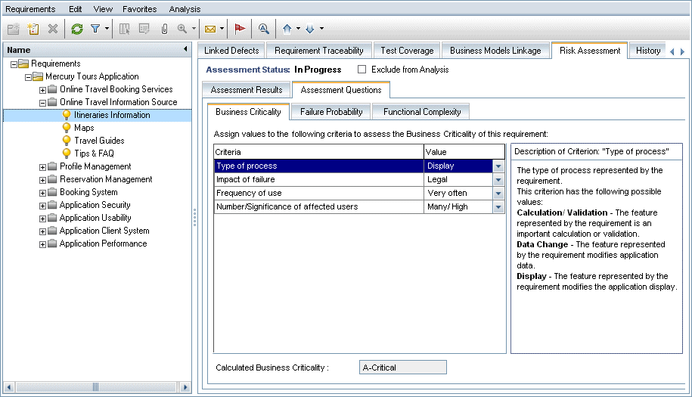
Risk Assessment Tab

Slide 28
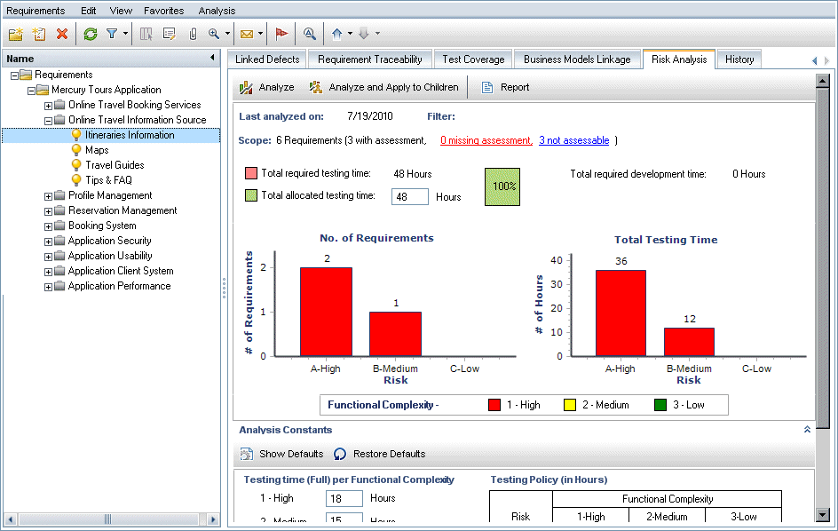
Risk Analysis Tab

Slide 29
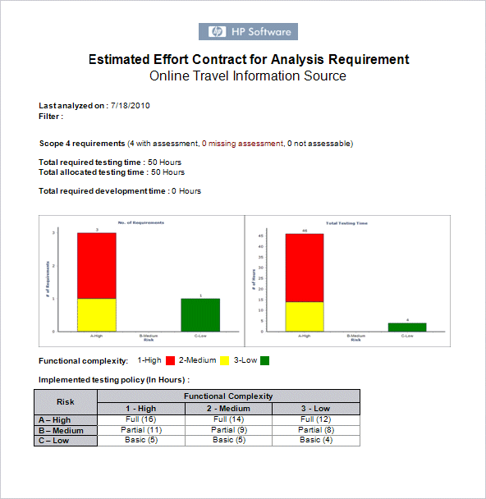
Risk Analysis Report

Slide 30
Test Plan Module

Slide 31
Test Plan Overview
Create a test plan tree
Create dependencies with test resources – optional
  Associate tests with a set of resources that you upload to the ALM repository.
  Define test parameters
  To make tests more flexible, you can include parameters in test steps
  Define test configurations
  To run tests for different use-cases, you can define test configurations. This enables you to run the same test under different scenarios
  Create test steps
  Create test steps describing the operations to perform and their expected results.
  Automate tests
  After designing test steps, decide which tests to automate. Factors influencing test automation include frequency of execution, volume of data input, length of execution time, and complexity
  Create requirements coverage
  Link each test in the test plan tree with a requirement or requirements in the requirements tree.
  Link a test to a defect
  Link a test to specific defects. This is useful, for example, when a new test is created specifically for a known defect. By creating a link, you can determine if the test should be run based on the status of the defect.
  Analyze test plan data
  Analyze the test plan by generating reports and graphs.
  Establish a baseline
  After your test plan has been reviewed and approved, you can create a baseline. A baseline provides you with a snapshot of your test plan at a specific point in time. Use a baseline to mark any significant milestone in the application lifecycle.

Slide 32
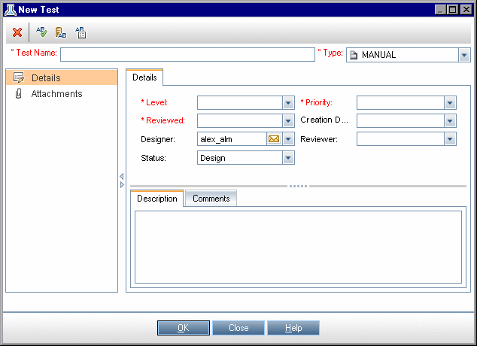
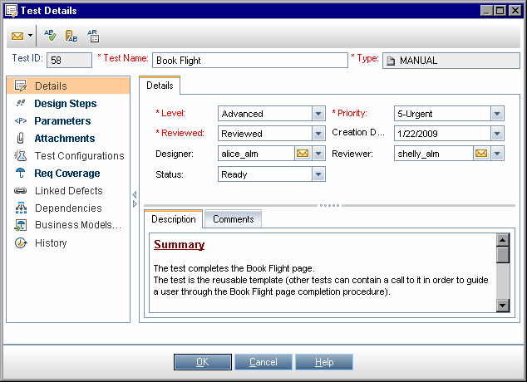
How to Create Tests
Create test subjects
Create tests in the test plan tree
Import tests – optional
Create a manual template test – optional
  To create a manual template test:
  Create a manual test, as described in Step 2 – "Create tests in the test plan tree.“
  Right-click the new test in the test plan tree, and select Mark as Template Test. The test icon changes from gray to white, indicating that it is now a template test.
Create a QuickTest template test – optional
  To create a QuickTest template test:
  Create a QuickTest Professional test, as described in Step 2: "Create tests in the test plan tree".
  Right-click the new test in the test plan tree, and select Mark as Template Test. The test icon changes from gray to white, indicating that it is now a template test.
Add steps to tests

Slide 33
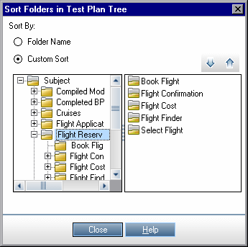
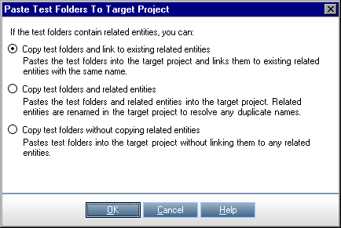
Test Plan
Sort Folders in Test Plan Tree Dialog Box
  Custom Sort Enables you to reorder the subfolders in a selected test subject folder.
  Select a test subject folder in the left pane, and rearrange the subfolders in the right pane by dragging or using the vertical arrows.
  Folder Name Sorts the subfolders alphabetically in the selected test subject folder.
Paste Tests/Folders to Target Project Dialog Box
  This dialog box enables you to choose how ALM copies a test or test subject across projects

Slide 34
How to use Test Parameters
Prerequisites
  A manual test is defined in the test plan tree.
Define test parameters
  In the Parameters tab, plan and define the test parameters you will use in the test design steps. For user interface details, see "New Test Parameter/ Test Parameter Details Dialog Box" on page 568.
Add parameters to a design step
  While creating design steps, click Insert Parameter to add a parameter to a design step. The Parameters dialog box opens.
  Alternatively, in the description or expected result of a design step, type a new or existing parameter name, using the syntax <<<parameter name>>>. If you typed a new parameter, it is automatically added to the test parameter grid.
  If you apply formatting to a parameter name in a design step, you must apply the same formatting to the entire parameter name, including the <<< and >>> characters. For example, if you want to italicize the parameter <<<password>>>, you must italicize the entire string <<<password>>> and not just the word password.
Assign actual values to parameters
  Before you run a test, ALM prompts you to assign actual values to the parameters included in the test. The actual value is the data that is used during the test run. You can take the parameter default values and use them as actual values. ALM prompts you to assign actual values at three stages of designing your test.
  When you call a test with parameters. If you assign actual values to parameters when you call a test, the values are automatically applied to each test instance that you create from the calling test.
  When you create a test instance. If you assign actual values to parameters when you create a test instance, the values are automatically applied to each run of the test instance
  When you run a test. If you assign actual values to parameters for a test run, the values apply to that test run only. If you do not assign actual values at this stage, the test will run with null values.

Slide 35
How to use Test Resources
Create resources
  Open the Test Resources module. On the ALM sidebar, under Testing, select Test Resources.
  Create folders. Right-click the Resources root folder and select New Resource Folder. To create a sub-folder, right-click a folder and select New Resource Folder.
  Add resources to folders. Right-click a folder or sub-folder and select New Resource. Fill in the fields in the New Resource dialog box.
Upload resource files
  You can upload files for each resource in the test resource tree to the ALM repository. Select a resource in the test resource tree and click the Resource Viewer tab.
  Business Process Testing: When working with application areas, launch the testing tool in the Application Area Viewer tab to work with the resource.
Download resource files
  To view and edit your test resources, you can download them to a local directory. Select a resource in the test resource tree and click the Resource Viewer tab.
Define dependencies
  You define dependencies between entities from your testing tool, You can also define dependencies between entities by writing your own application.
View dependencies
  View the relationships between entities such as tests, components, and test resources. You can view the entities that depend on a selected entity, and the entities on which a selected entity depends.
  Select a resource (Test Resources module), test (Test Plan module) or component (Business Components module) and click the Dependencies tab

Slide 36
Requirements Coverage

Slide 37
Requirement and Test Coverage Overview
It is essential that the tests in your test plan meet your original requirements. To keep track of the relationship between your requirements and tests, you add links between them.
In the Test Plan module, you create requirement coverage by selecting requirements to link to a test. Requirement coverage assists you in assessing the impact of a change in the test or requirement. A test can cover more than one requirement.
Alternatively, in the Requirements module, you create test coverage by linking tests to a requirement. Test coverage assists you in assessing the impact of a change in the test or requirement. A requirement can be covered by more than one test
How to create Links
  Link requirements to tests
  In the Test Plan module, select the Test Plan Tree view.
  Select a test and click the Req Coverage tab. Click the Select Req button to display the requirements tree in the right pane. Add to coverage your selected requirements.
  Link tests to requirements
  In the Requirements module, select the Requirement Details view.
  Select a requirement and click the Test Coverage tab. Click the Select button to display the test plan tree in the right pane. Add to coverage your selected tests.

Slide 38
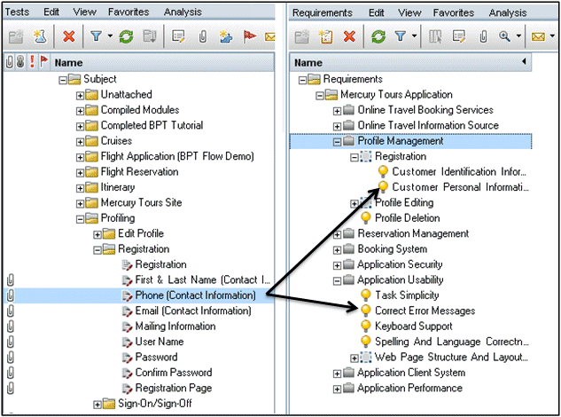
Link Requirement to Tests
For eg. The Phone (Contact Information) test verifies the customer phone number in the Registration page. If you click the Req Coverage tab, you can see that this test covers the following requirement topics: Customer Personal Information, and Correct Error Messages.

Slide 39
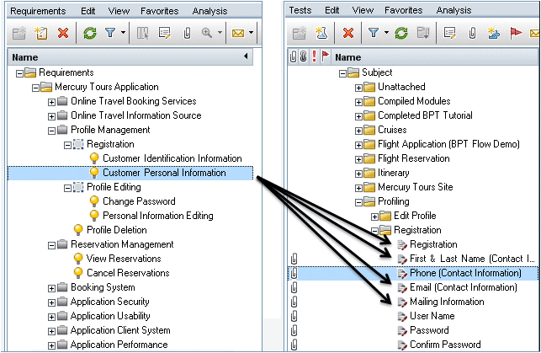
Link tests to requirements
For eg: The Customer Personal Information requirement ensures that the flight reservation system includes personal information about the customer. In the Test Coverage tab, you can see that this requirement is covered by the following tests: Email (Contact Information), First & Last Name (Contact Information), Mailing Information, Phone (Contact Information), and Registration.

Slide 40
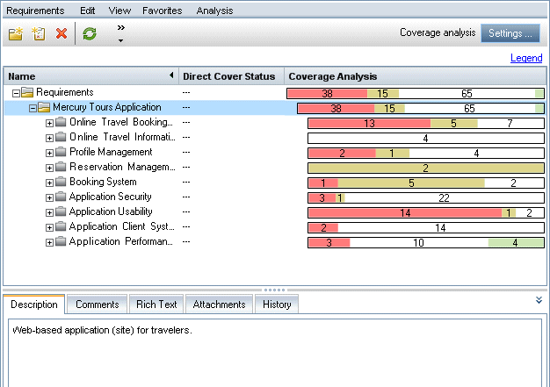
Analyze Coverage
The requirement “Application Client System” located under the requirement “Mercury Tours Application” has twelve children, including itself. In the Coverage Analysis, you can see that two of the children have a status of Failed (one or more of the tests covered by the requirement failed). When you analyze this, you can see that three (27%) of the tests associated with this requirement failed.

Slide 41
Test Lab Module

Slide 42
Test Execution
A test set contains a subset of the tests in an HP Application Lifecycle Management (ALM) project designed to achieve specific test goals. As your application changes, you run the manual and automated tests in your project in order to locate defects and assess quality.
Running Tests Manually
You can run tests manually in ALM using:
  HP Sprinter: Sprinter provides enhanced functionality to assist you in the manual testing process. ALM Editions: Sprinter functionality is not available with Quality Center Starter Edition and Performance Center Edition.
  Manual Runner. If you are not working with Sprinter, you can run tests manually using Manual Runner. You can run manual and automated tests manually in ALM. When you run a test manually, you follow the test steps and perform operations on the application under test. You pass or fail each step, depending on whether the actual application results match the expected output.
Running Tests Automatically
  You run tests automatically using Automatic Runner.
  You can run manual and automated tests automatically.
  When you run an automated test automatically, ALM opens the selected testing tool automatically, runs the test on your local machine or on remote hosts, and exports the results to ALM.
  When you run a manual test automatically, ALM notifies a designated tester by email to run the test on a specified host.

Slide 43
How to Run Tests
Create test sets
  Start by creating and defining test sets in the Test Lab module. After you have created test sets, you assign test set folders to cycles defined in the releases tree in the Releases module.
Schedule test runs
  You can set conditions, and schedule the date and time for executing your tests. You can also set the sequence in which to execute the tests.
Run tests manually
  You can run manual and automated tests manually, executing the test steps that you defined during test planning.
Run tests automatically
  You can select manual and automated tests in a test set to run automatically.
Run performance tests
  Performance Center: You can run performance tests to create load on an application and test its performance.

Slide 44
How to Run Tests contd..
  View and analyze test results
  View test results. After you run tests, review results to determine if the actual results match the expected results of the tests.
  Analyze run data by creating graphs and reports. Use one of the following:
    View dynamic graphs of test set folders. In the test sets tree, select a test folder, and click the Live Analysis tab.
    View test set data in a graph. On the Test Lab module menu, select Analysis > Graphs.
    Create a report of test set data. On the Test Lab module menu, select Analysis > Reports.
  Link to a defect
  If a defect has been detected, you can create a new defect and link it to the test set, test instance, test run, or run step, or link an already-existing defect.

Slide 45
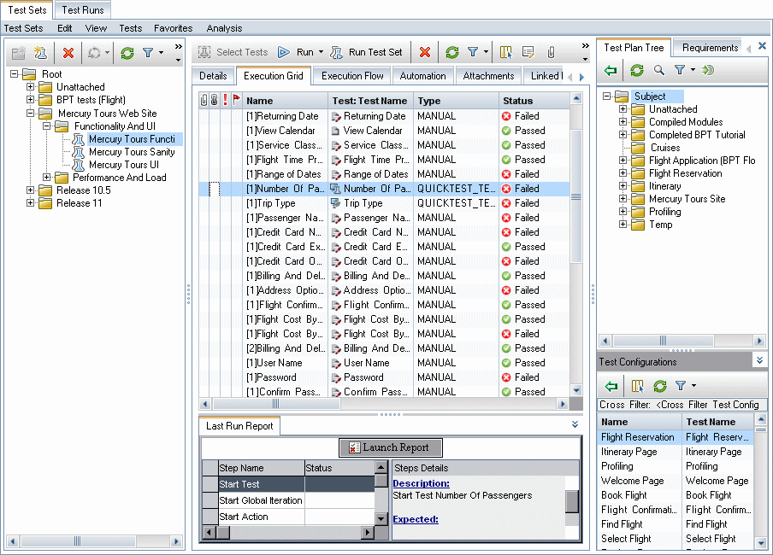
Test Lab Module

Slide 46
How to create Test sets
  Define test sets
    Define a hierarchical framework for your test sets by creating a test sets tree that can contain folders and subfolders.
    Open the Test Lab module. On the ALM sidebar, under Testing, select Test Lab.
    Create folders. Right-click the Root folder and select New Folder. To create a sub-folder, right-click a folder and select New Folder.
    Add test sets to folders. Right-click a folder and select New Test Set.
  Assign test set folders to cycles
    Assign test set folders to cycles defined in the releases tree in the Releases module. Right-click a test set folder and select Assign to Cycle.
  Add tests to test sets
    You can add manual and automated tests to a test set. In the Test Lab module > Test Sets tab, select a test set and click the Execution Grid tab or the Execution Flow tab. Then click the Select Tests button.
  Set notification rules
    Set test set notification rules to instruct ALM to send email to a specified user if selected events occur for a test set. You set notification rules in the Automation tab, Notification area.
  Set On Failure rules
    Set On Failure rules which instruct ALM in the event that an automated test in the test set fails. You set notification rules in the Automation tab, On Automatic Test Failure area.
  Pin a test set to a baseline – optional
    You can pin a test set to a baseline to associate the test set with the versions of the tests stored in a baseline you select.
    In the Test Lab module, right-click a test set and select Pin to Baseline.
    To clear a pinned baseline, right-click a test set and select Clear Pinned Baseline.

Slide 47
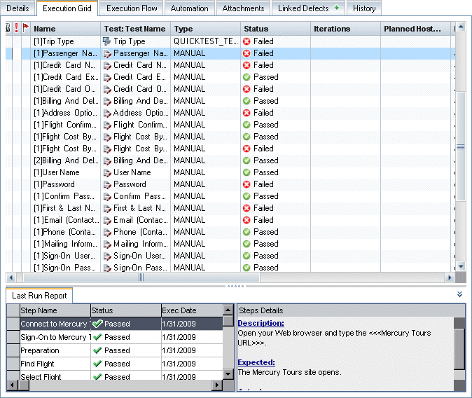
Execution Grid Tab

Slide 48
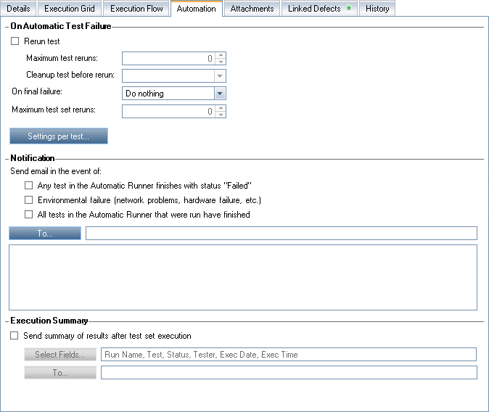
Automation Tab

Slide 49
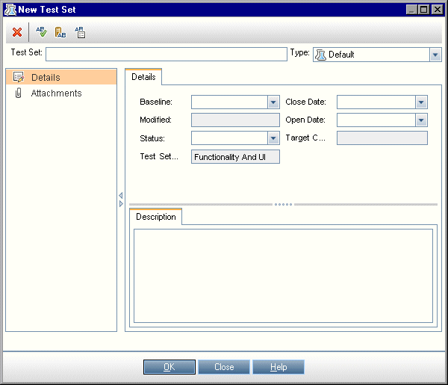
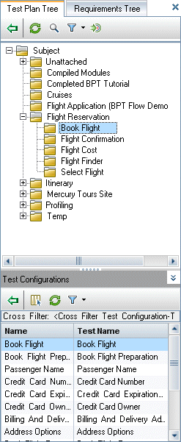
New Test Set Dialog Box
Select Tests Pane

Slide 50
Test Run Schedules
Test Run Schedules Overview
  You can control the execution of test instances in a test set. Using the Execution Flow tab of the Test Lab module, you can specify a date and time, and set conditions for executing a test instance.
  A condition is based on the results of another specified test instance in the Execution Flow. By setting conditions, you can instruct the Test Lab module to postpone execution of the current test instance until the other specified test instance has either finished running or passed. You can also set the sequence in which to execute the test instances.
Display a test set
  In the Test Lab module, select a test set from the test lab tree. Click the Execution Flow tab.
Schedule a test run
  In the Execution Flow tab, right-click a test instance and choose Test Run Schedule. The Run Schedule dialog box opens.
  In the Execution Conditions tab, specify the execution conditions for the test instance.
  In the Run Schedule dialog box, click the Time Dependency tab. Specify the date and time for running each test instance.
Example:
  You can determine that test_2 will run only if test_1 passed, and test_3 will run only if test_2 passed. test_1 is scheduled to run at 9:00 AM.
View the execution flow diagram
  You can change the way the Execution Flow is displayed. This includes zooming in and out of the diagram, rearranging the tests in a hierarchical layout, refreshing the diagram, and displaying full test names in the diagram. You can also copy the diagram to the Clipboard.

Slide 51
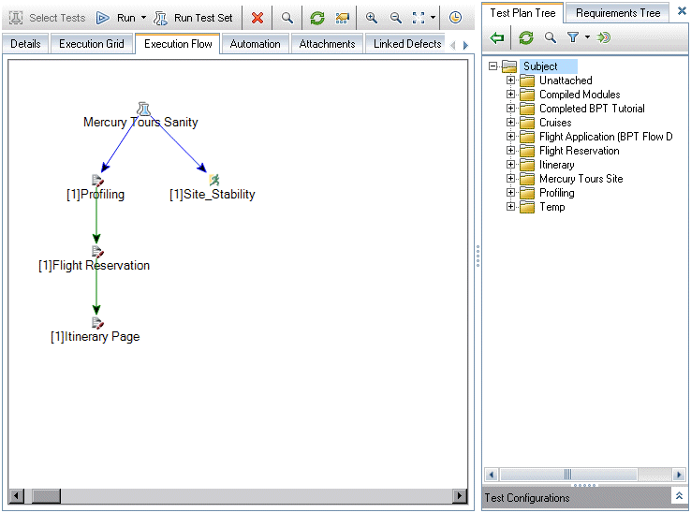
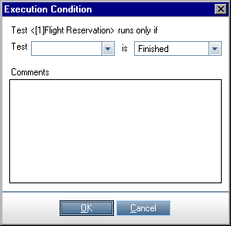
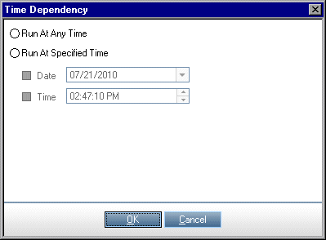
Execution flow Tab
A blue line arrow indicates that the test instance is to be executed after the previous test instance, with no conditions.
A green line arrow indicates that the test instance is to be executed only if the previous test instance has status Passed.
A black line arrow indicates that the test instance is to be executed only if the previous test instance has finished running.

Slide 52
Manual Test Execution
When you run tests manually, you follow the test steps and perform operations on the application under test. You pass or fail each step, depending on whether the actual application results match the expected output. You can run both manual and automated tests manually.
Sprinter Overview
  You run tests manually from HP Application Lifecycle Management (ALM) using HP Sprinter. Sprinter provides advanced functionality and tools to assist you in the manual testing process. Sprinter is fully integrated with ALM, enabling you to get the maximum benefit from both solutions.
  Sprinter addresses these needs of the manual testing process, and enables you to accomplish these tasks without disrupting your test flow. With Sprinter, you can also perform many of the repetitive and tedious tasks of manual testing automatically.
With Sprinter you can:
  create and annotate screen captures
  capture movies of your run
  record and run macros on your test application
  automatically enter data into fields in your application
  automatically include the list of your steps or user actions in any defect you submit
  replicate your user actions on multiple machines with different configurations

Slide 53
How to Run Tests Manually
Run tests with Sprinter
  If Sprinter is installed on your computer, you can run tests manually with Sprinter from the Test Lab module.
  In the Test Lab module > Test Sets tab, select a test set and click the Execution Grid tab or Execution Flow tab.
    To run a single manual test, select the test and click the Run button.
    To run two or more manual tests, select the tests. Click the drop-down arrow next to the Run button and select Run...(Sprinter).
Run tests from the Manual Runner dialog box
  If you are not working with Sprinter, you can also run tests manually from the Manual Runner dialog box.
  In the Test Lab module > Test Sets tab, select a test set and click the Execution Grid tab or Execution Flow tab. Select the tests, click the drop-down arrow next to the Run button, and select Run Manually.
  Open the application being tested and execute the test steps. Follow the instructions detailed in the test step descriptions.
  Compare the actual results with the expected results. When performing the steps, decide whether the application responds according to the expected results.
  Assign a pass or fail status to each step, depending on whether or not the expected results match the actual results.
  If a step fails, explain how the application actually responded. A test fails if one or more steps fail.
Edit test steps during a test run
  While executing a test using the Manual Runner, you can add, delete, or modify test steps. After you finish executing the test, you can save your design steps with the changes you make. Edit test steps during a manual run from the Manual Runner: Step Details page

Slide 54
Manually Execute Tests
Resume a manual test run
  If a manual test run was paused during execution, you can continue the run at a later stage. This continues the run using the same runner that was used the first time the test was run (Sprinter or the Manual Runner).
  Use one of the following:
    In the Execution Grid tab or Execution Flow tab, select the test you want to resume running, and select Tests > Continue Manual Run.
    Alternatively, click the Run arrow and choose Continue Manual Run.
Results
  After test execution is complete, you can view a summary of test results in the Test Lab module:
  Test Sets tab: The updated status for each test run is displayed in the Execution Grid. Results for each test step appear in the Last Run Report pane. You can view more detailed results in the Test Instance Details dialog box.
  Test Runs tab: The updated status for each test run in the project is displayed

Slide 55
How to Run Tests Automatically
Schedule and order test execution
  You can decide how and when tests are run:
  Scheduling: You can specify the date and time, and set conditions for executing your tests.
  Ordering: You can set the order in which you want your tests to be executed, using the Order Test Instances dialog box. Use one of the following:
    In the Execution Flow, press the CTRL key and select two or more tests. Right-click a test and select Order Test Instances. Execution Grid, select Tests > Order Test Instances.
Run a test concurrently on multiple hosts
  To run the same test concurrently on multiple remote hosts, add multiple instances of the test to your test set.
Run tests
  Run manual and automated tests automatically on your machine or on remote hosts using the Automatic Runner.
  In the Test Lab module > Test Sets tab, use one of the following:
    Select a test set that includes one or more automated tests and click the Run Test Set button.
    To run selected tests, select a test set and click the Execution Grid tab or Execution Flow tab. Select one or more tests and click the Run button.
    To run only manual tests, select the tests and click the Run button. In the Manual Test Run dialog box, select Automatic Runner and click OK.
View the execution log
  You can view details about the automatic test execution after execution is complete. In the Automatic Runner dialog box, select Run > View Execution Log.
Results
  After the test execution is complete, you can view a summary of test results in the Test Lab module:
    Test Sets tab: Updated status for each test is displayed in the Execution Grid. for each test step in the Last Run Result pane. You can view detailed results in the Test Instance Details dialog box.
    Test Runs tab: The updated status for each test run in the project is displayed

Slide 56
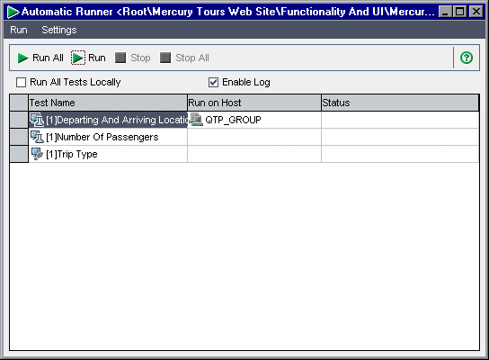
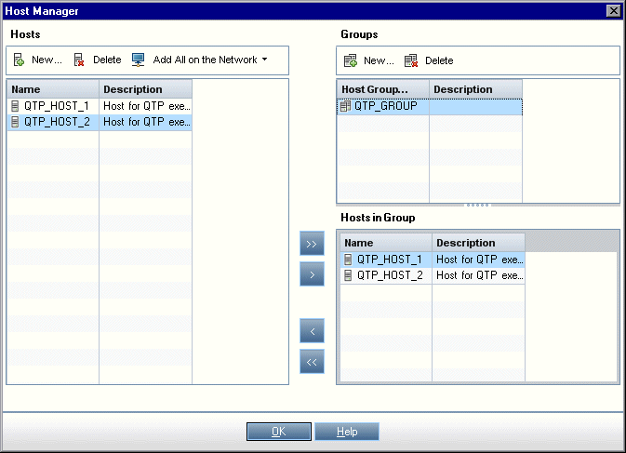
Automatic Runner
Host Manager Dialog Box
This dialog box enables you to create a list of available hosts for remote test execution. You can also organize hosts into groups to be used for a specific project

Slide 57
Defect Module

Slide 58
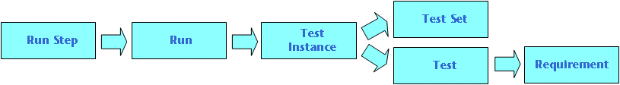
Defect Tracking
Locating and repairing application defects efficiently is essential to the development process
Defect Linkage
  You can link a defect to the following ALM entities: requirements, business, tests, test sets, business process tests, flows, test instances, runs, run steps, and other defects.
  The diagram below shows the indirect links that ALM creates if a defect is linked to a run step.

Slide 59
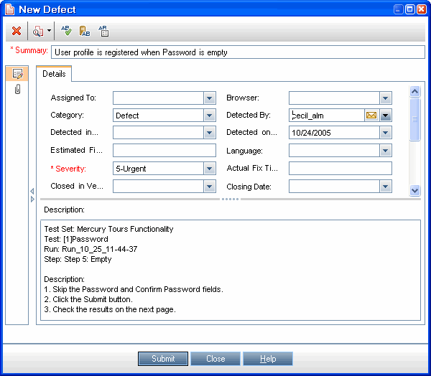
How to Track Defects
Create defects
Import defects – optional
Link defects and other entities
Search for defects
Assign, repair, and update defects
Analyze defects
Track Defects - Use-Case Scenario
  Create defects
  Search for duplicate defects
  Link defects and other entities
  Assign and repair defects while testing new application builds
  Analyze defects

Slide 60
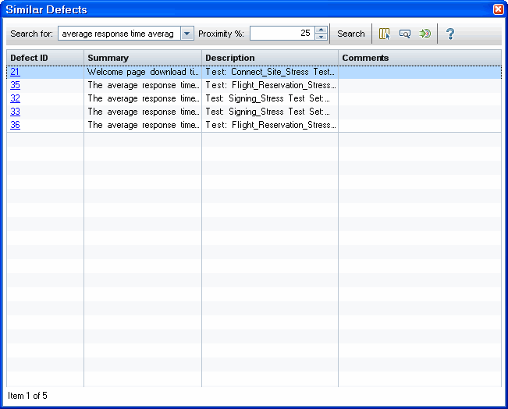
Similar Defects
The Similar Defects dialog box enables you to check for similar defects before submitting a new defect. The Similar Defects pane enables you to check for similar defects at any time from the Defects grid.

Slide 61
Version Controlling

Slide 62
Version Control
In a version control enabled project, we can create and manage HP Application Lifecycle Management (ALM) entities while maintaining previous versions of those entities. This includes requirements, tests, test resources, business process models, and business components.
  Check in
  Check out
      Checked out by current user
      Checked out by another user
Examples:
  Monitor changes and compare versions.
  Restore an earlier version.
  Lock entities for editing.

Slide 63
How to Use Version Control
Version control functionality is available in Requirements, Business Models, Test Plan, and Test Resources modules
Prerequisites
  Verify that version control is enabled for your project
Check out an entity –
  Automatic checkout. When you start editing an entity, ALM displays the Check Out dialog box, enabling you to check out the entity. To instruct ALM to automatically check out entities that you start editing, without displaying the Check Out dialog box, click Don’t show this again in the Check Out dialog box.
  Manual check out. Select one or more entities. On the module toolbar, click Check Out .
Undo a checkout - optional
  When an entity is checked out, you can undo the checkout to cancel your changes. Right-click the entity and select Versions > Undo Check Out

Slide 64
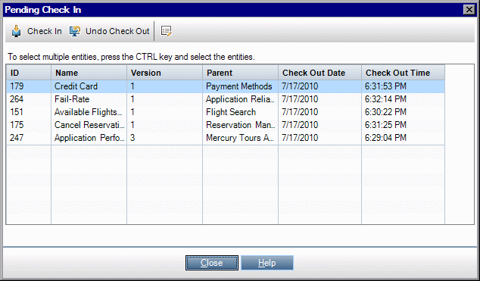
How to Use Version Control .contd..
Check in an entity
When you finish making changes, check in the entity to create a new, updated version available to other users. Use one of the following:
  Check in a single entity. Right-click the entity and select Versions > Check In.
  Check in multiple entities. Select the entities. On the module toolbar, click Check In.
View all checked out entities – optional
You can view all entities in the current module that you have checked out, and check in or undo the checkout for selected entities. Click the Check In button in the top right corner of the ALM window.

Slide 65
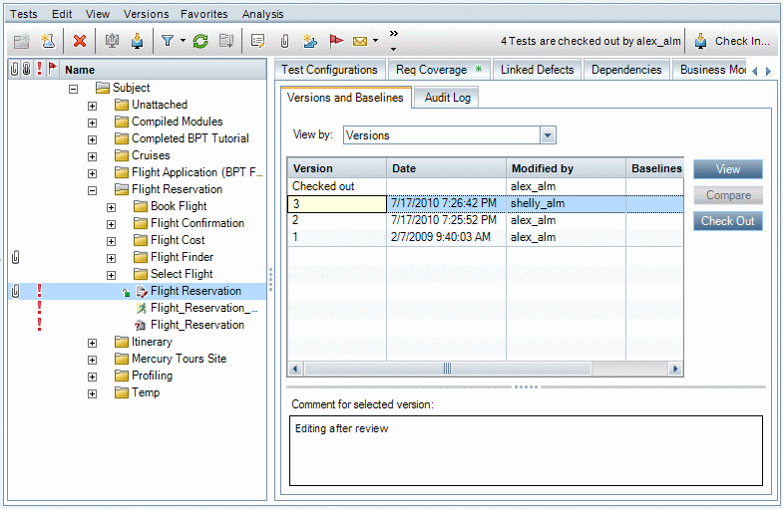
How to Use Version Control .contd..
Access version history
  To view, compare, and check out previous versions of an entity, select the entity and click the History tab > Versions and Baselines tab.

Slide 66
Version Control .contd..
Pending Check In Dialog Box
  This dialog box enables you to view all entities in the current module that you have checked out, and check in or undo the check out for selected entities.

Slide 67
Library Management

Slide 68
Libraries and Baseline
A library represents a set of entities in a project and the relationships between them. The entities in a library can include requirements, tests, test resources, and business components.
A baseline is a snapshot of the library at a specific point in time. You can compare baselines at all stages of the application development lifecycle.
Baseline – To keep track of changes made to the project over time.
Importing a library enables you to reuse and share an existing set of entities. As development continues, you can compare and synchronize libraries – Available in Premier Edition.
Baseline Examples - Establish content of a release - stakeholder sign off, Monitor change, Evaluate the impact of changes

Slide 69
Baseline
Pinned Test Sets
  You can pin a test set to a baseline. When you pin a test set to a baseline, the tests that are in the test set are associated with the versions of the tests stored in a baseline you select. When you run the tests in a pinned test set, the versions of the tests stored in the specified baseline are run.
  A pinned test set can include only tests that are included in the baseline. When you pin a test set to a baseline, tests that are not a part of the baseline are removed from the test set. In addition, all test runs are deleted from the test set. When you add tests to a pinned test set, you can select only tests that are included in the baseline.
  You can also clear a pinned test set. If the test set includes tests that no longer exist in the Test Plan module, the tests are deleted from the test set. In addition, all test runs in the test set are deleted. The tests in the test set are then associated with the current tests in the Test Plan module.

Slide 70
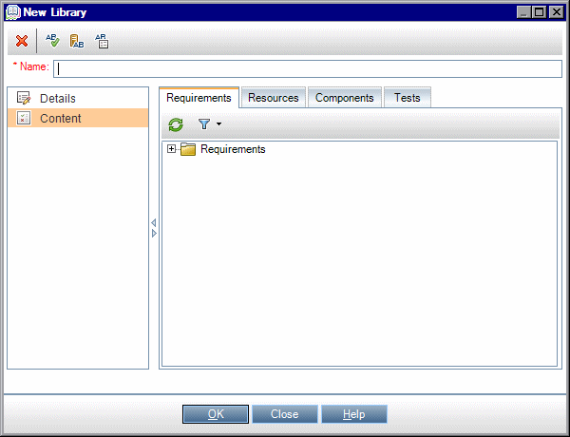
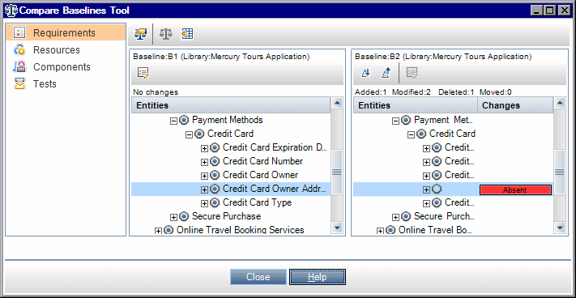
How to Use Library
1. Create/Import a library
2. Create a baseline
3. Monitor library tasks – optional
On ALM Masthead select Tools>Task Manager
4. Compare baselines
5. Pin a test set to a baseline
  In the Test Lab module, right-click a test set and select Pin to Baseline.
  To clear a pinned baseline, right-click a test set and select Clear Pinned Baseline.
6. View baseline history
View and compare all versions of an entity that are stored in a baseline.
  Select an entity in the tree or grid, and click History tab > Baselines tab.
  Version Control: Select an entity and click History tab > Versions and Baselines tab. In the View By box, select Baselines

Slide 71
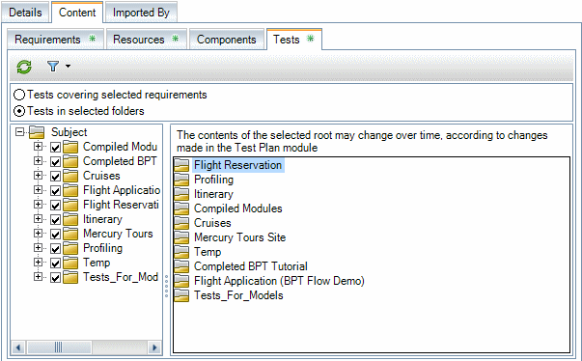
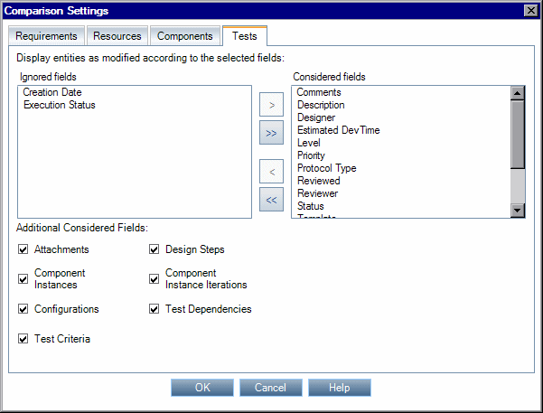
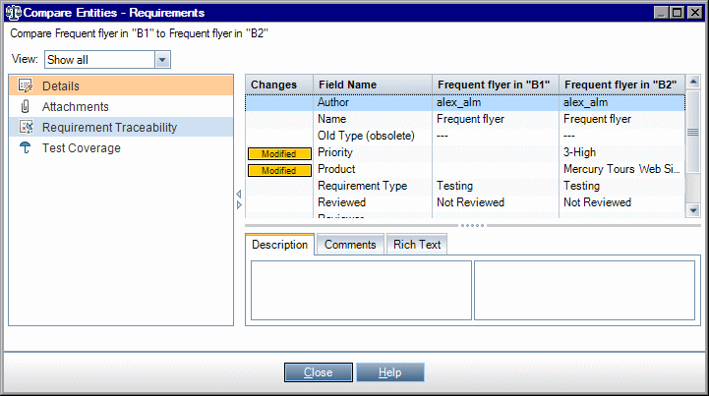
Library and Baseline
Content Tab
Comparison Settings Dialog Box
Compare Entities Dialog Box

Slide 72
Import Library
Importing a library enables you to share or reuse an existing set of entities in projects across your enterprise. You import a library by selecting a baseline in another library from which to import
Imported Library Examples - Reuse requirements and tests for a new release, Create a set of requirements, tests, and resources for use by multiple applications, Update imported libraries with changes made in the source library, Update a source library with developments in an imported library.
Library Synchronization
  You can synchronize two associated libraries to update one library with changes made in another library. You can update an imported library with changes made in the source library. You can also update a source library with changes made in the imported library.
  During synchronization, data from the other library’s baseline is copied to your library.
Library Verification
  Requirement type check
  Entities compatibility check
  Library size check – LIBRARY_FUSE Configuration Parameter in the Site Administration.

Slide 73
How to Share Libraries
Prerequisites
  Verify that a baseline has been created for the library you want to import
  Business Process Testing: Before importing a project with application areas to another project, make sure you have connected to the destination project at least one time from within QuickTest Professional
Import a library
  In the Libraries module, right-click a library folder and select Import Library.
  View Log
  Refresh to see the updated details in the Details Tab
  Compare libraries
  In the libraries tree, right-click a library and select Compare To. Select a library with which to compare, and choose one of the following:
    Latest Baseline Created. Compare the library with the most recent baseline created in the other library.
    Select Baseline. Select a baseline in the other library with which to compare. Opens the Select Baseline dialog box. Click the browse button to select a baseline from the list.
    Available for: a source library or an imported library.
  To save the library comparison results in .csv file format, click the Export Comparison Results button. After saving, the file opens in the default application defined for opening .csv files on your computer, such as Microsoft Excel.

Slide 74
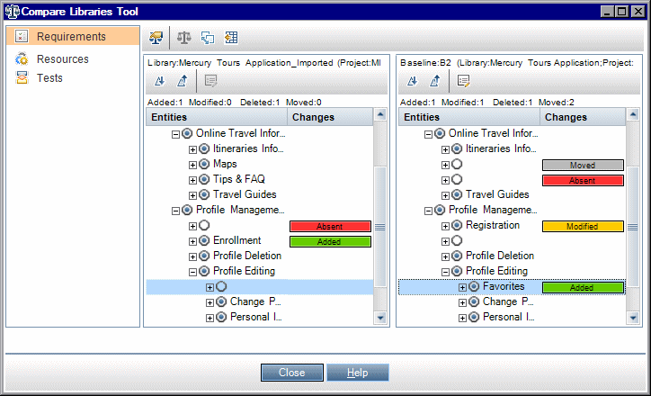

How to Share Libraries..Contd..
Synchronize libraries
  In the libraries tree, select the library that you want to update. Using the Compare Libraries Tool, compare the library by selecting a baseline in the other library with which to synchronize
  In the Compare Libraries Tool, click the Synchronize button . The Library Verification dialog box opens, displaying the verification results.
  Click Continue to start the synchronization
  Close the Compare Libraries Tool dialog box. Synchronization continues in a background process, and may take some time. You can continue working in your project during the synchronization process.
  Click the View Log button in the Details tab. The Log: Synchronize Libraries dialog box opens and displays progress.
Monitor library tasks
  When you import or synchronize libraries, these tasks are performed in the background, enabling you to continue working in your project while the processes are running. You can view the status and progress of all asynchronous tasks for the project using the Task Manager. On the ALM masthead, select Tools > Task Manager.

Slide 75



How to Share Libraries..Contd..

Slide 76
Reporting & Analysis

Slide 77
How to Analyze Data in ALM
Generate a graph
  View selected data in a graph format
  View selected Project Planning and Tracking data in a graph format
Generate a dashboard page
  Group together selected graphs and view them in a single display
Generate a project report
  Produce a project report of selected data.
Generate an Excel report
  Extract data from the project database with SQL queries, and format the data in Microsoft Excel.
Manage analysis items and dashboard pages
  Organize analysis items and dashboard pages in the analysis and dashboard trees. Create folders, move, copy, rename, and delete items.
Generate a Live Analysis graph
  Live Analysis graphs enable you to create and display dynamic graphs related to test plan subjects and test sets.
Generate a project document
  Project Documents enable you to create a Microsoft Word document containing selected project data.

Slide 78

Analysis View
This window enables you to create, manage and view analysis items.
Analysis items include graphs, project reports, Excel reports and standard
reports

Slide 79

Dashboard View
This window enables you to create, manage and view dashboard pages.

Slide 80

Graphs and Dashboard Pages
How to Generate a Graph
  Launch the Graph Wizard
  Create a predefined graph
  Create a graph in Analysis View
  Configure a graph
  View a graph
  Edit graph categories
  Drill down to graph data
  Share a graph outside ALM
    Allow ALM users or others to view
    read-only versions of graphs outside ALM.
      In the analysis tree, right-click a graph, and select Share Analysis Item.
      In the Share Analysis Item dialog box, select a share option. A URL of the selected graph is copied to the clipboard.
      Paste the URL in a website or email.
      Click the URL to open a read-only version of the graph in a web browser. Each time you access the graph, it displays the most up-to-date information.
  Create a dashboard page

Slide 81


How to Generate a Dashboard Page
Create a dashboard page
Configure a dashboard page
View a dashboard page
  This tab enables you to view a dashboard page, and drill down to the graph data.

Slide 82
PPT Graphs
Prerequisites
  Under Management, select Releases. Define a release, release scope items, milestones, and KPIs.
Create a graph in Analysis View
  Create a graph in the Analysis View module.
  Open the Analysis View module. On the ALM sidebar, under Dashboard, select Analysis View.
  Add a folder to the analysis tree. Right-click a folder under the Private or Public root folder, and select New Folder.
  Create a new graph. Right-click a folder. Select New Release Analysis and choose a PPT graph. The New Graph dialog box opens.
Configure a graph
  In the Analysis View module, select a graph, and click the Configuration tab.
View a graph
  In the Analysis View module, select a graph in the analysis tree, and click the View tab.
Create a dashboard page
  View several graphs together in a dashboard page.

Slide 83


PPT Graphs

Slide 84
Project Reports
Create a project report
  Add a folder to the analysis tree. Right-click a folder under the Private or Public root folder, and select New Folder.
  Create a new project report. Right-click a folder, and select New Project Report. Fill in the New Project Report dialog box.
  Define sections
  Configure document-level settings
  Configure sections
  Preview a template report
  Generate a template report

Slide 85

Generate Project Report

Slide 86

Excel Reports

Slide 87


Post-processing Tab

Slide 88

Queries

Slide 89
Thank You
© 2012, Cognizant

